Slide 1
Neural Networks Project 3
BURRA VENKATA KRISHNA KARTHIK
16230698

Slide 2
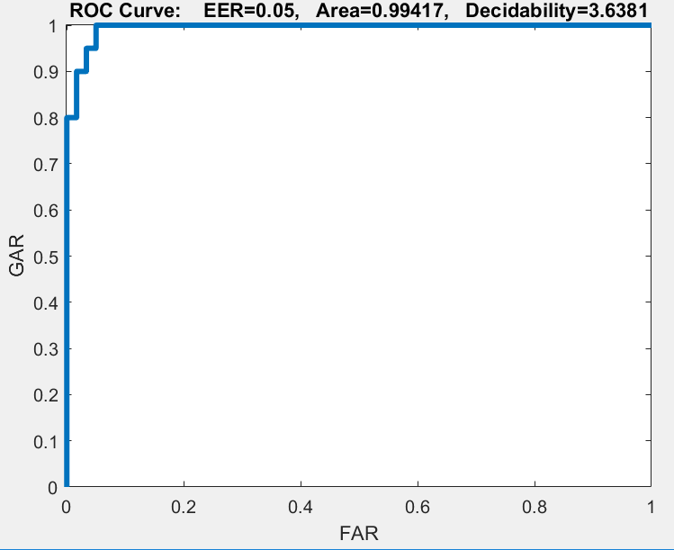
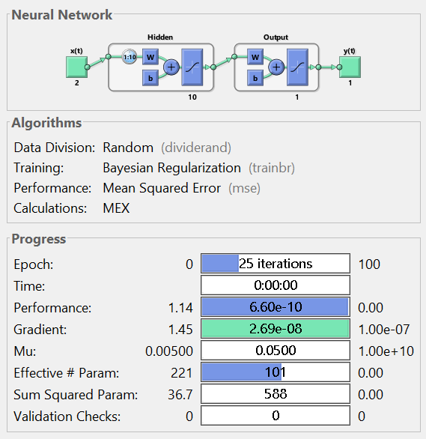
Pre-fold TDNN (Task1)
For n=20 , h=10 (best configuration)

Slide 3
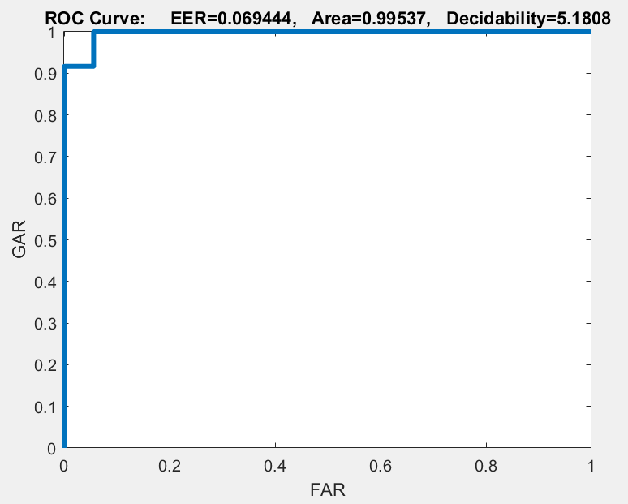
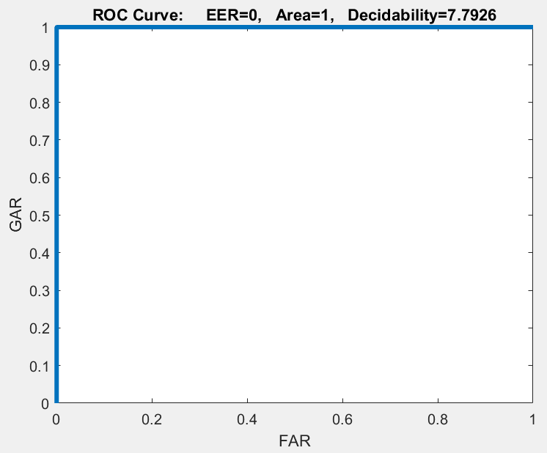
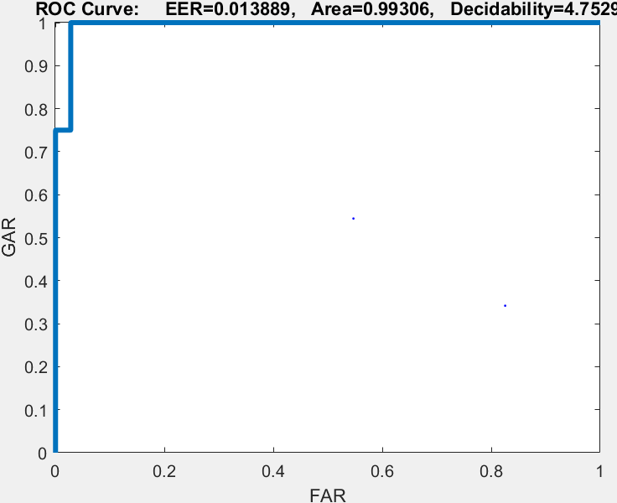
Subject specific -TDNN
Subject1
Subject2
Subject3

Slide 4
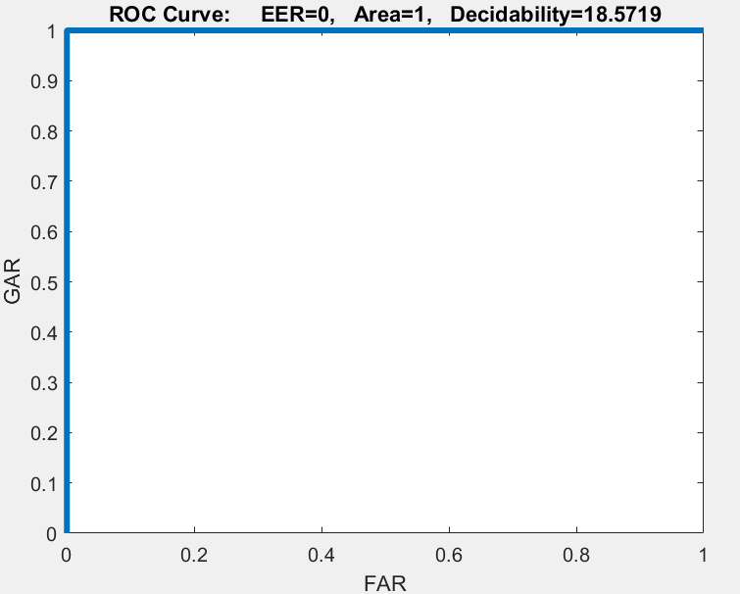
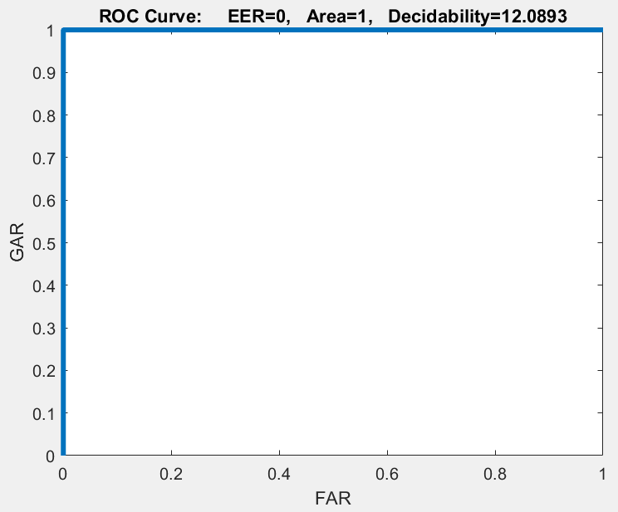
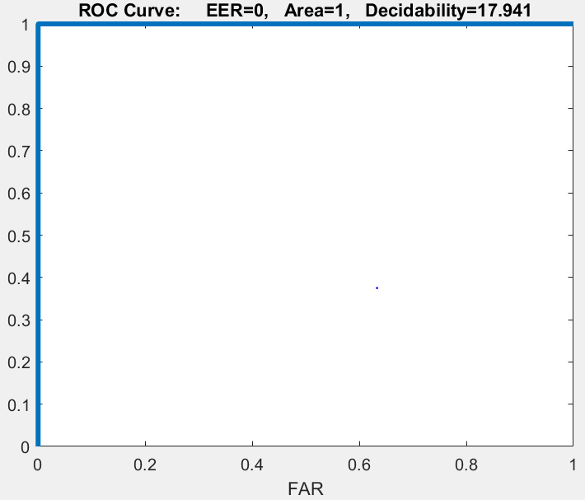
Subject specific -TDNN
Subject4
Subject5
Subject6

Slide 5
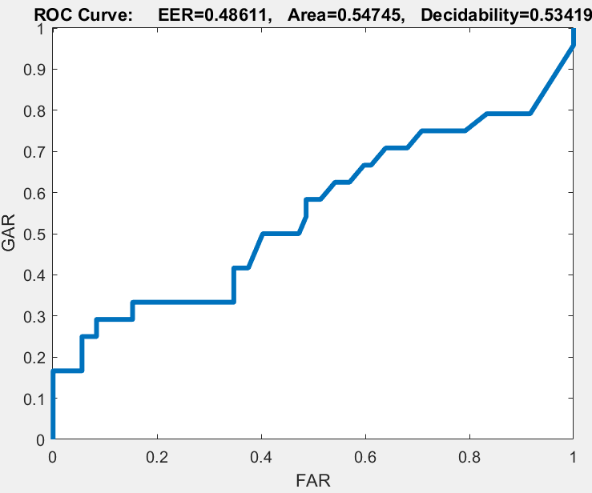
Subject independent -TDNN

Slide 6
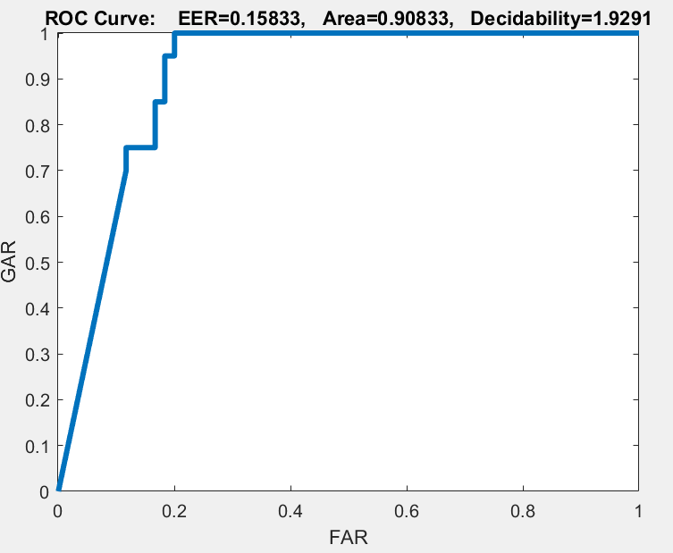
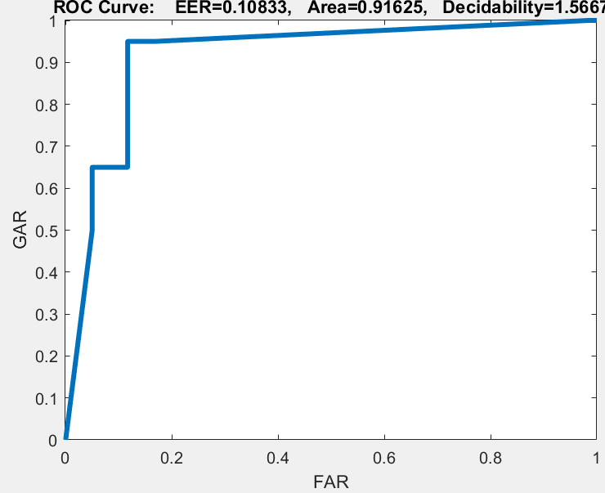
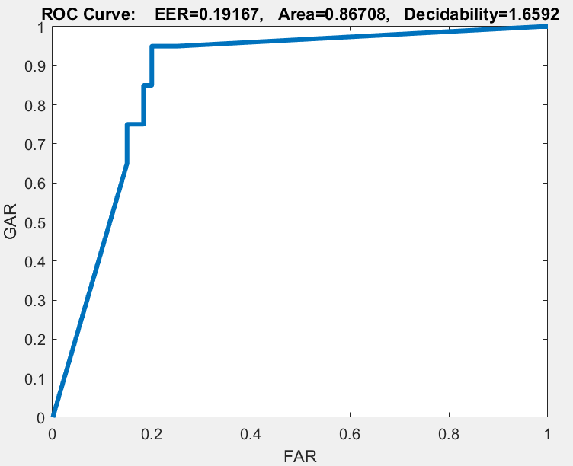
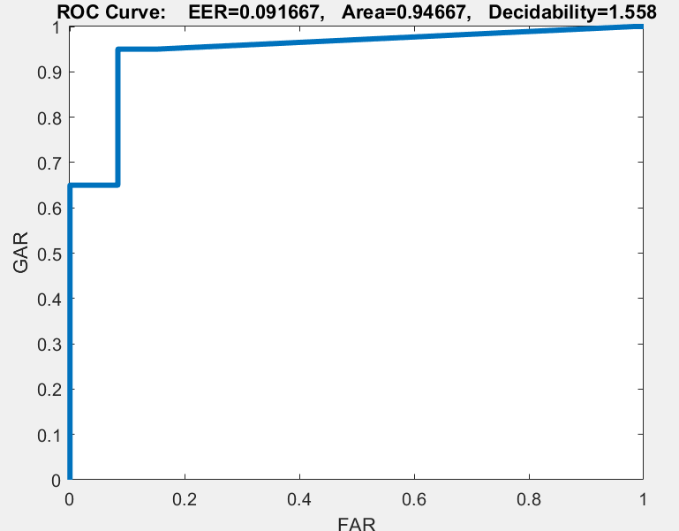
Pre-fold NARX
n=4,n1=2,h=5
N=4,n1=2,h=6
n=4,n1=3,h=5
n=4,n1=3,h=6

Slide 7
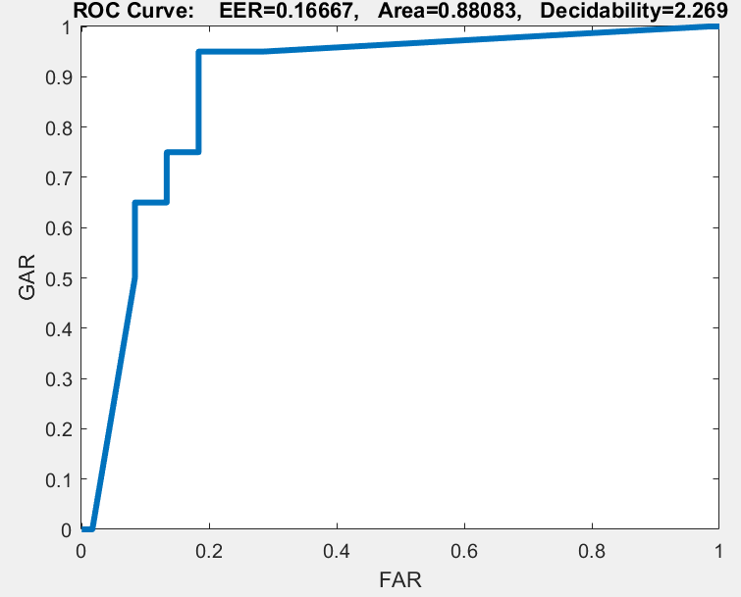
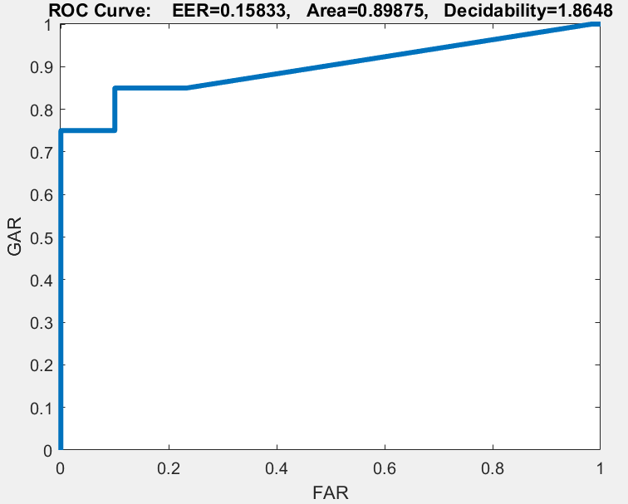
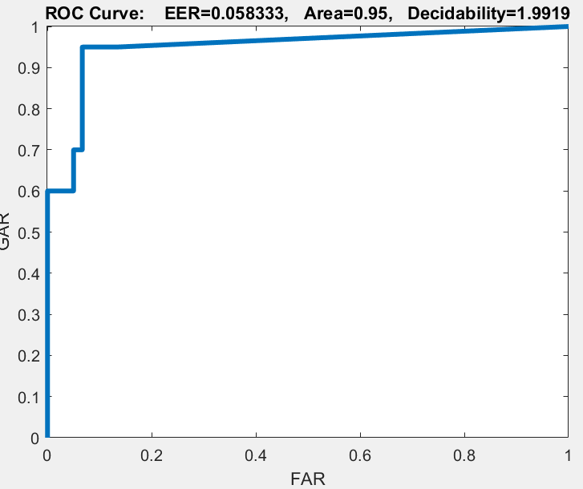
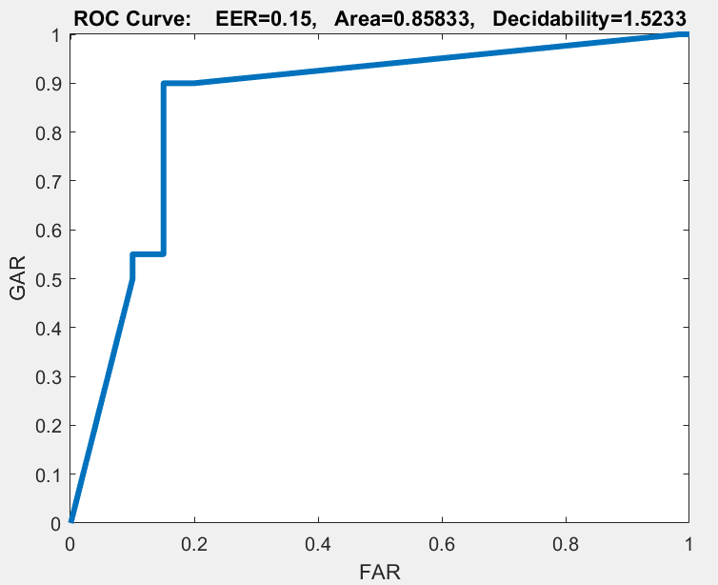
Pre-fold NARX
n=4,n1=4,h=5
N=4,n1=4,h=6
n=6,n1=2,h=5
n=6,n1=2,h=6

Slide 8
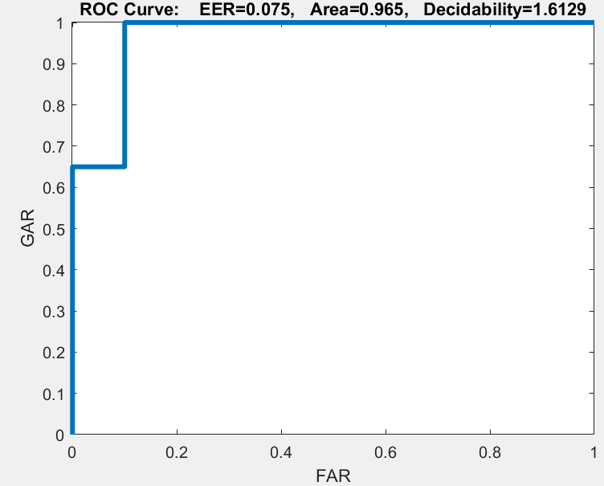
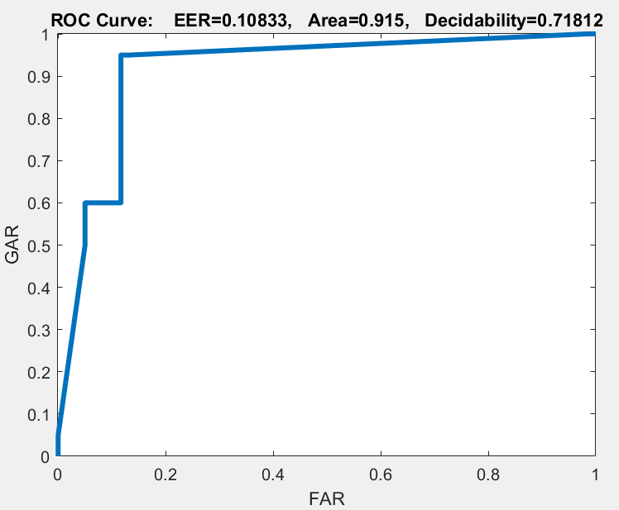
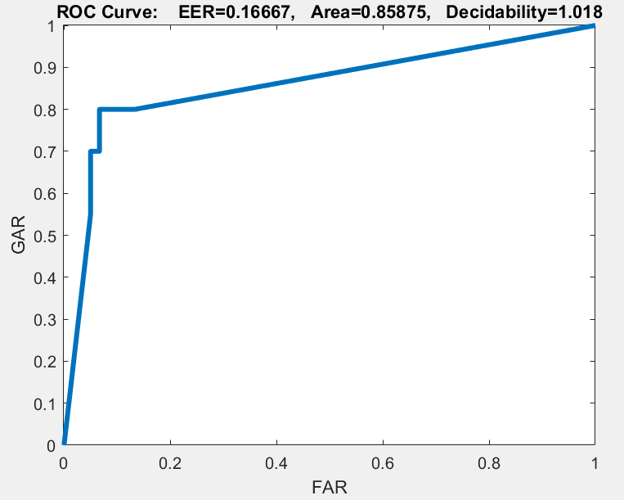
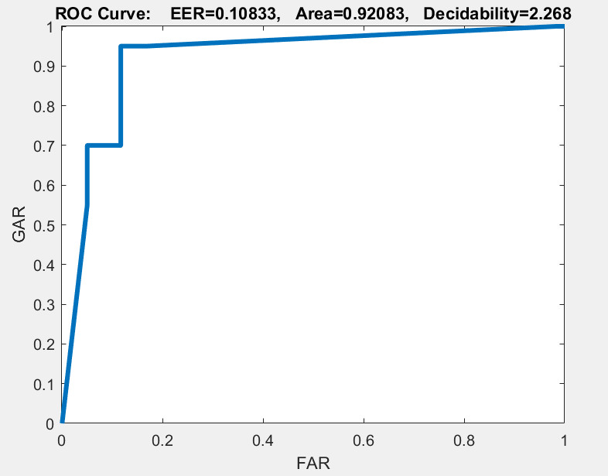
Pre-fold NARX
n=6,n1=3,h=5
N=6,n1=3,h=6
n=6,n1=4,h=5
n=6,n1=4,h=6

Slide 9
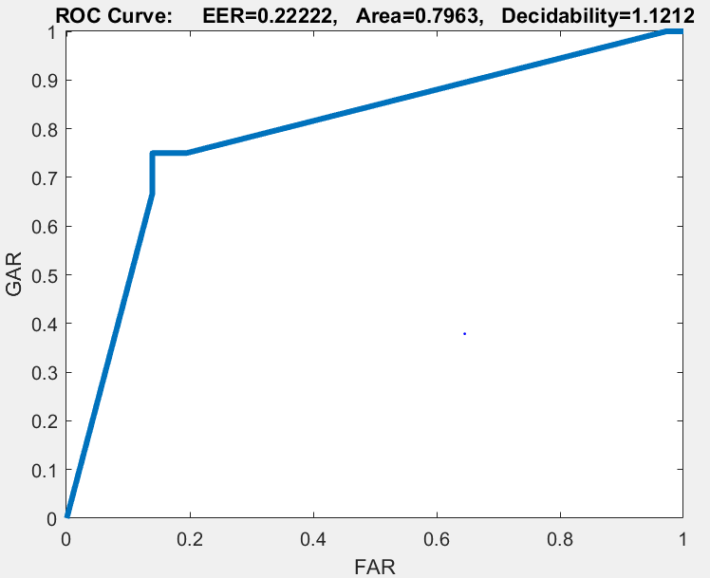
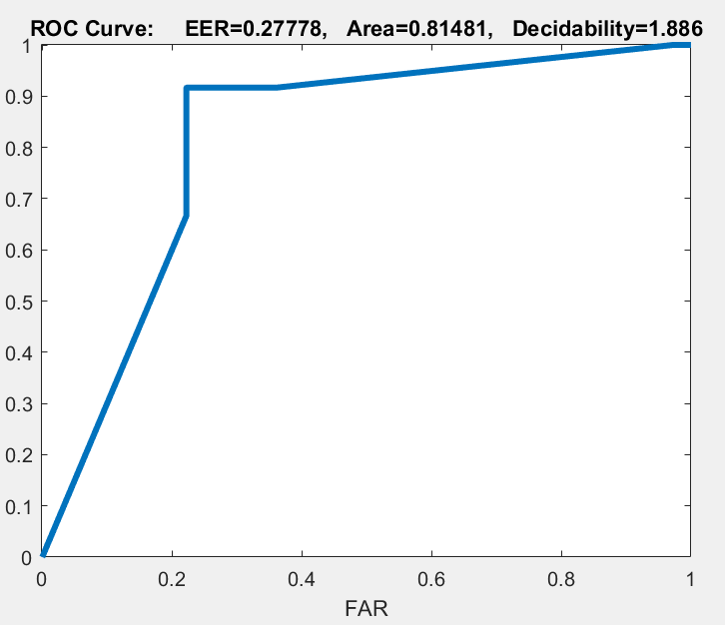
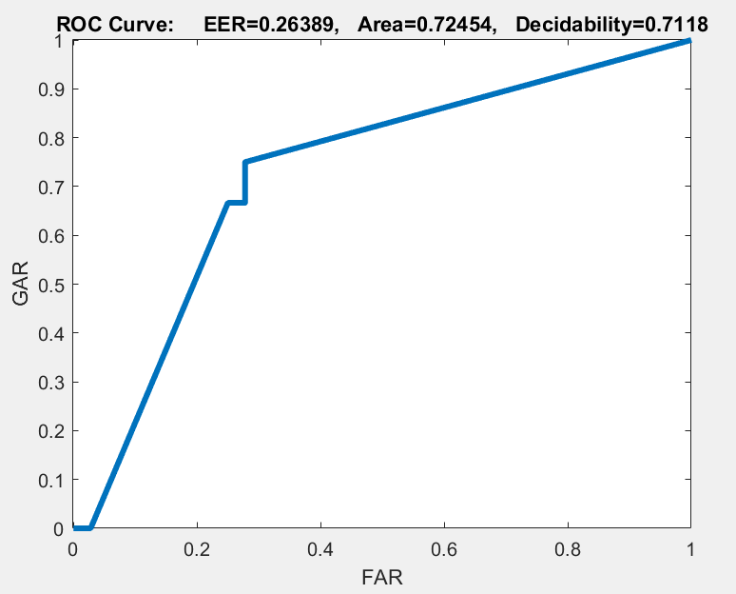
Subject specific -NARX
Subject1
Subject2
Subject3

Slide 10
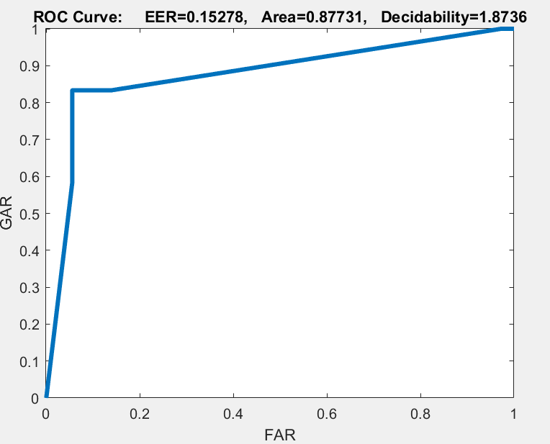
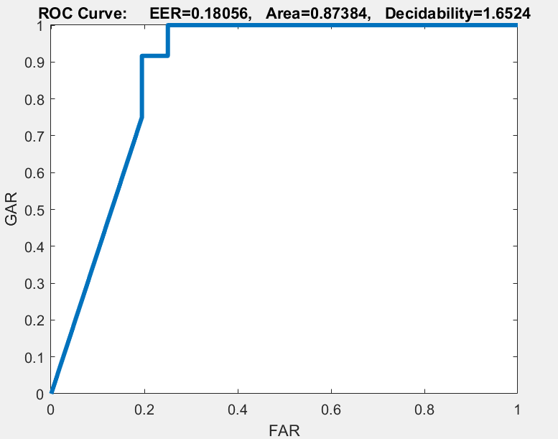
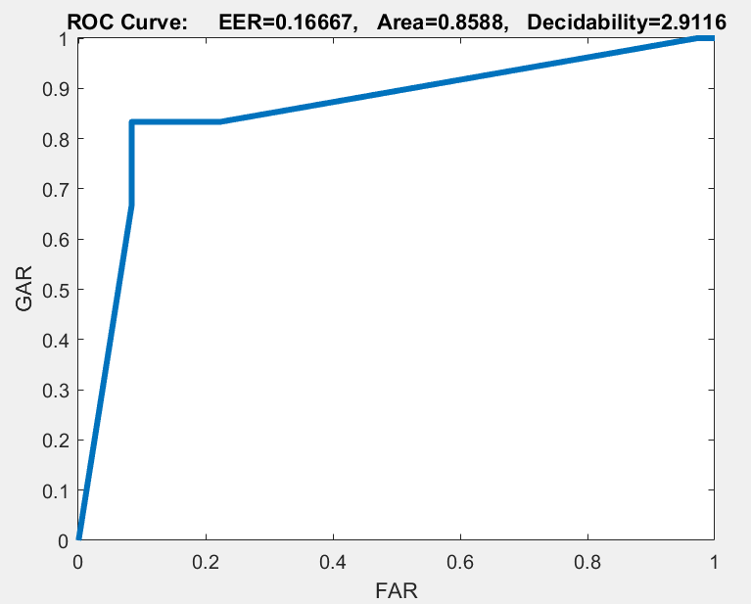
Subject specific -NARX
Subject4
Subject5
Subject6

Slide 11
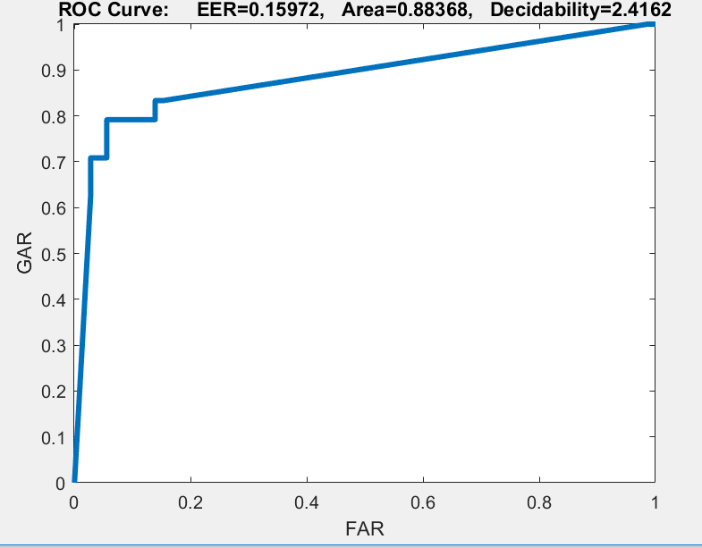
Subject independent -NARX

Slide 12
Conclusion
We see that TDNN is better than NARX neural net.
We see that subject specific is better than subject independent for TDNN and NARX neural nets.

